Slide 1
Radiation Protection: It’s Not Just the Numbers
Kathryn A. Higley, PhD, CHP
Rickert Professor and Head,
School of Nuclear Science and Engineering
Oregon State University
Corvallis, OR

Slide 2
First, a little background

Slide 3
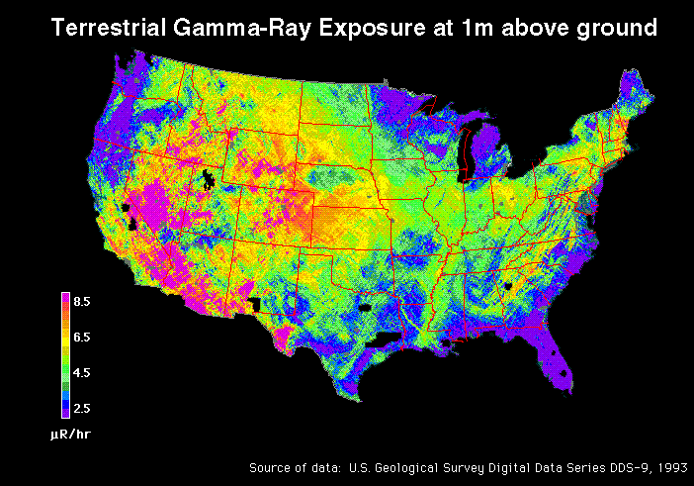
It’s not uniform spatially
Notes:
First a little background:
Ionizing radiation is everywhere: unseen, unheard, and unfelt. It exists naturally, coming to us from the cosmos, the soil under our feet, and even from within our own bodies.

Slide 4
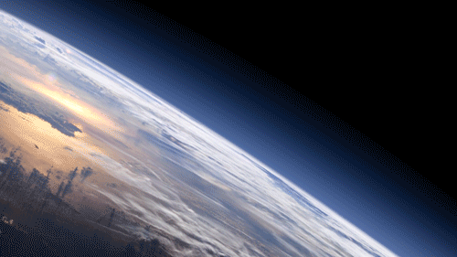
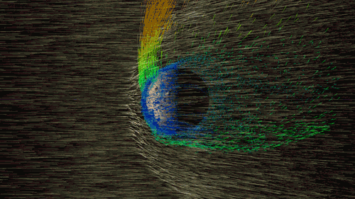
Or temporally
https://svs.gsfc.nasa.gov/12045
Notes:
The earth has been bombarded by radiation since the time it was formed

Slide 5
The early days of radiation protection ……hint: they weren't very protective

Slide 6
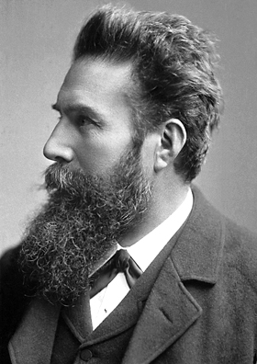
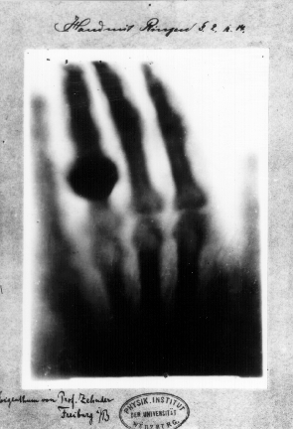
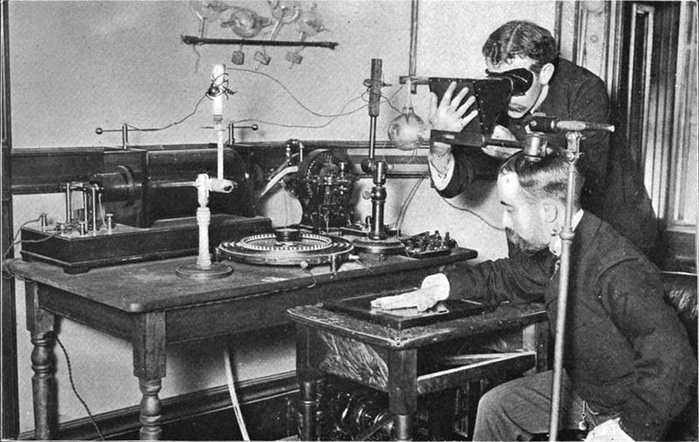
1895 onward
Notes:
For more than a hundred years, artificially generated ionizing radiation has played an integral part in the healing arts – diagnosing and treating disease, and saving countless lives in the process.

Slide 7
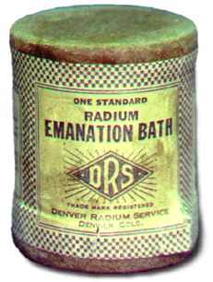
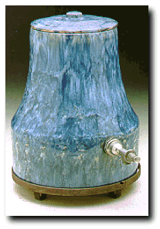
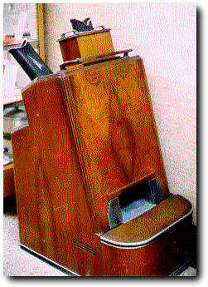
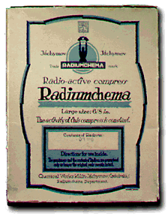
Fads followed the science……
https://www.orau.org/ptp/museumdirectory.htm
Notes:
There is a darker side to this story. Ionizing radiation exposure has occurred alongside some of the most horrific events in human history, and left a legacy of contamination in many parts of the world.
Today – scientific discoveries or announcements are followed quickly by commercialization – even if the accuracy of the claims have not been verified. The same was true nearly 100 years ago. Radium was discovered, and suddenly its in bath salts….
See https://www.orau.org/ptp/museumdirectory.htm

Slide 8
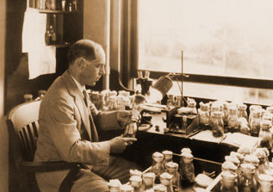
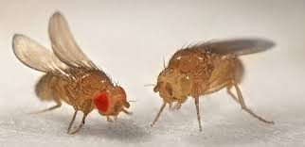
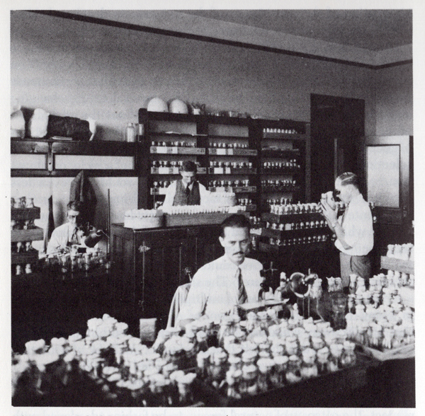
1927
Science scrambled to keep up……
Notes:
Ionizing radiation induces mutations
Herman J. Muller
Used Drosophila
X-rays
Radiation affected the germline, not only the soma

Slide 9
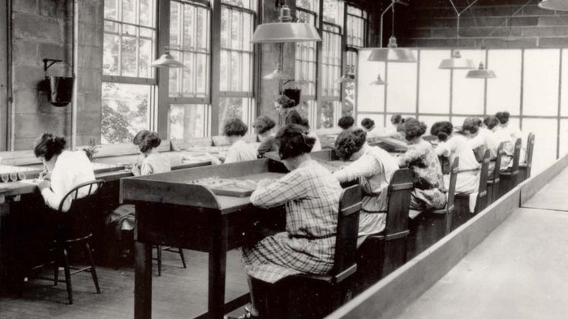
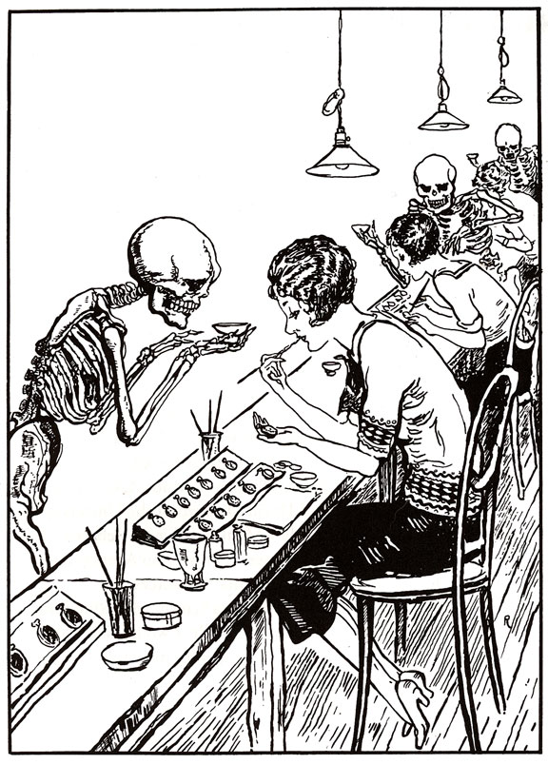
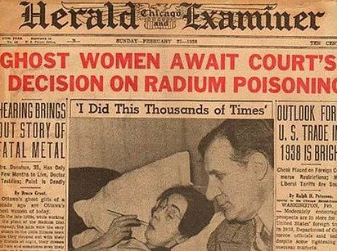
1917 – 1926
Industry raced ahead of the health and safety……
Notes:
Employees of the U.S. Radium Corp. paint numbers on the faces of wristwatches using radioactive paint.
Dozens of women, known as "radium girls," later died of radium poisoning.
One of the last radium girls died in 2014 year at age 107.

Slide 10
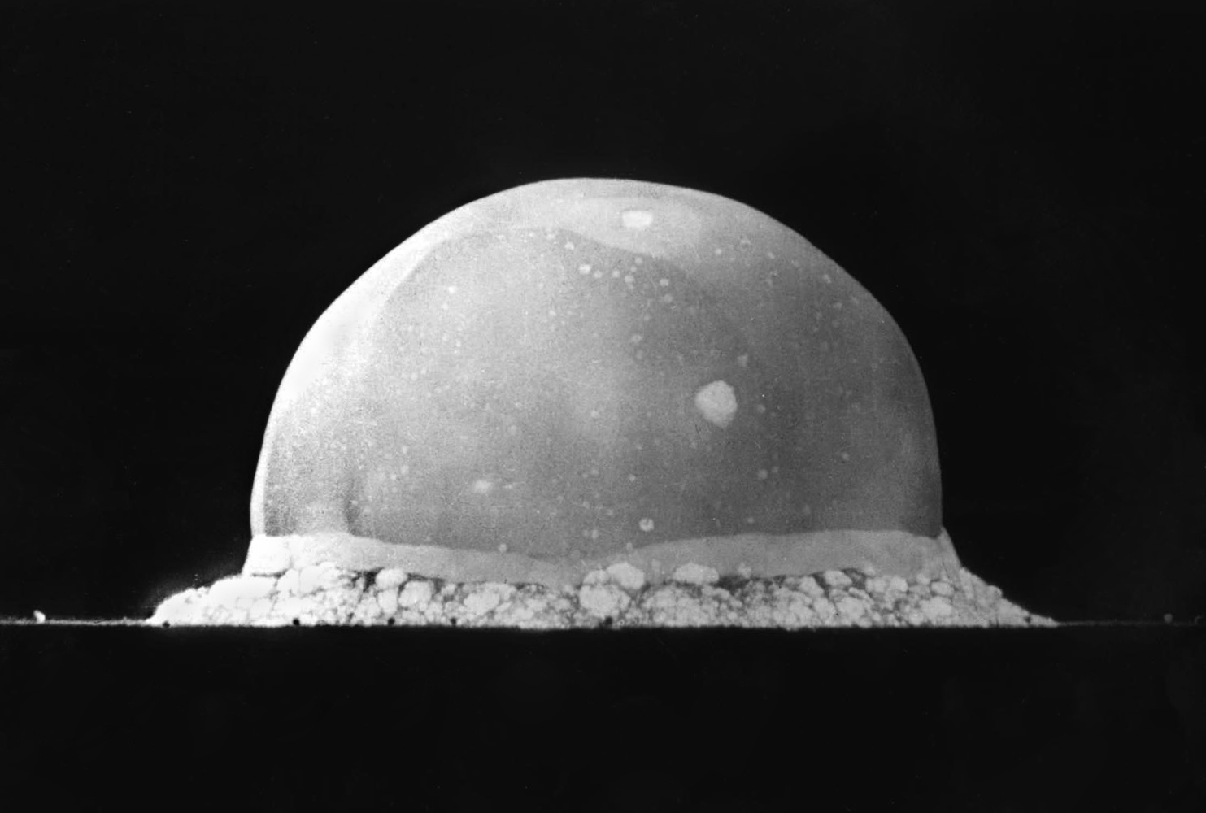
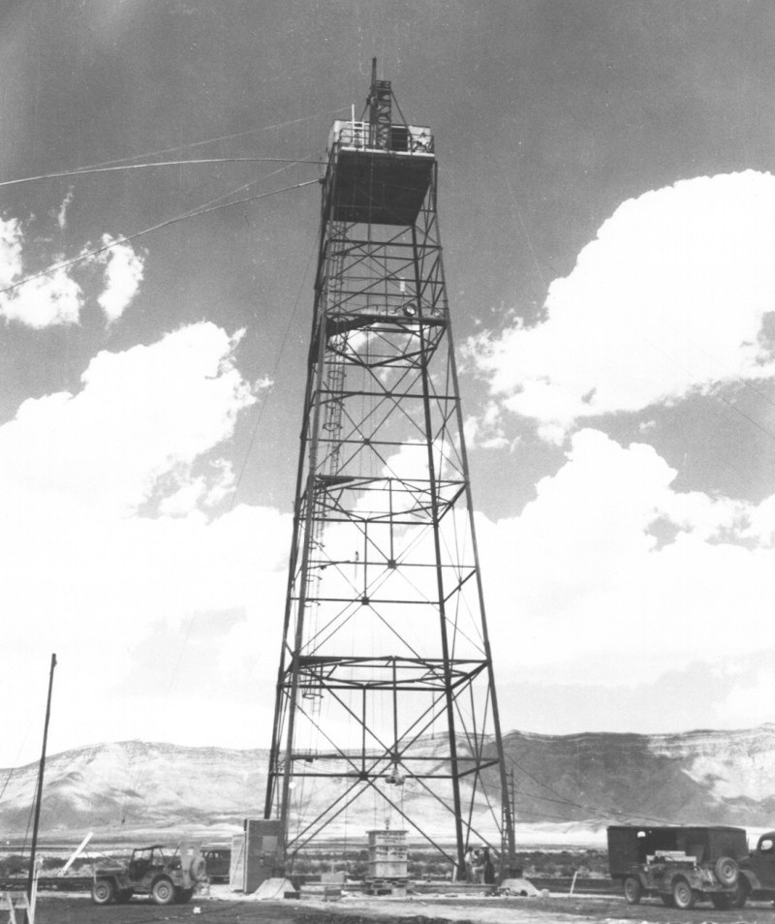
Science (and engineering) worked really hard and very fast……
Notes:
The Trinity explosion, 16 ms after detonation. The viewed hemisphere's highest point in this image is about 200 metres (660 ft) high.
https://commons.wikimedia.org/wiki/File:Trinity_tower.jpg
https://en.wikipedia.org/wiki/Trinity_(nuclear_test)#/media/File:Trinity_Test_Fireball_16ms.jpg

Slide 11
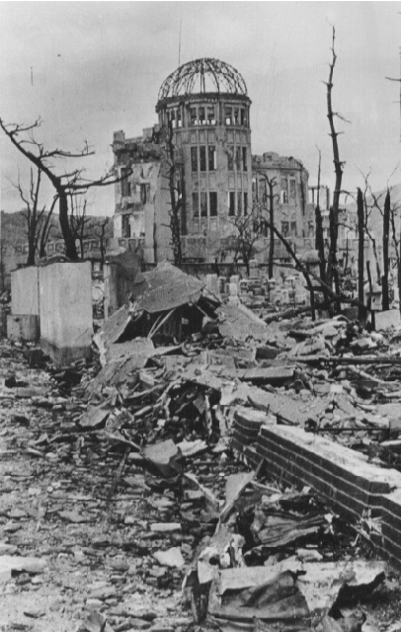
…..and took us where no one had gone before.
Notes:
In 1945 we detonated two weapons at Hiroshima and Nagasaki
The Manhattan Project produced two different types of atomic bombs, code-named Fat Man and Little Boy. Fat Man, which was dropped on Nagasaki, was the more complex of the two.
Hiroshima. The bomb was known as "Little Boy", a uranium gun-type bomb that exploded with about thirteen kilotons of force
Three days after the United States dropped an atomic bomb on Hiroshima, a second atomic bomb was dropped on Nagasaki on August 9 – a 21-kiloton plutonium device known as "Fat Man.”
It is not unlikely that the estimates of killed and wounded in Hiroshima (150,000) and Nagasaki (75,000) are over conservative.

Slide 12
And governments responded
Notes:
Because this is a scientific talk, we had to have a graph. Here it is. Notice that the occupational exposure limits have remain unchanged, even though the underlying scientific basis has……

Slide 13
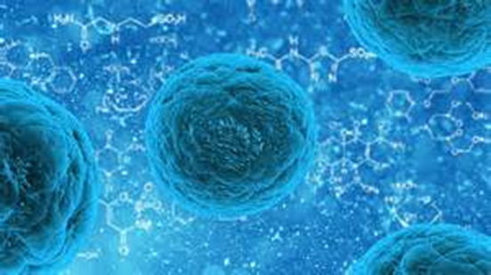
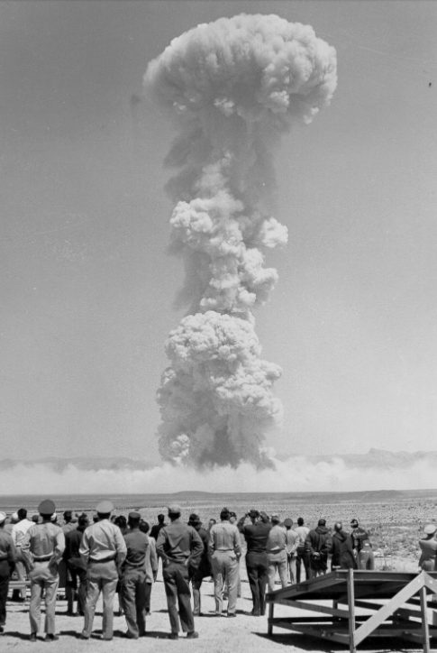
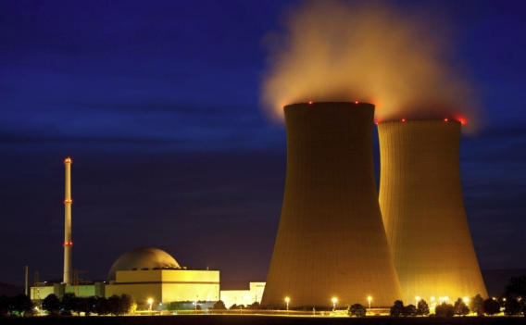
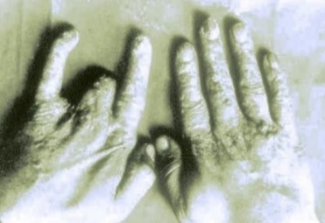
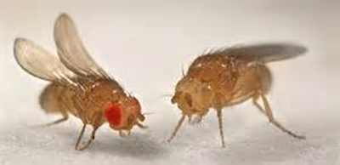
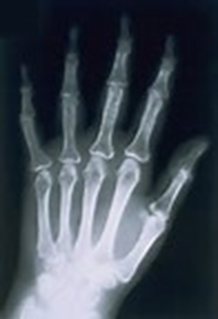
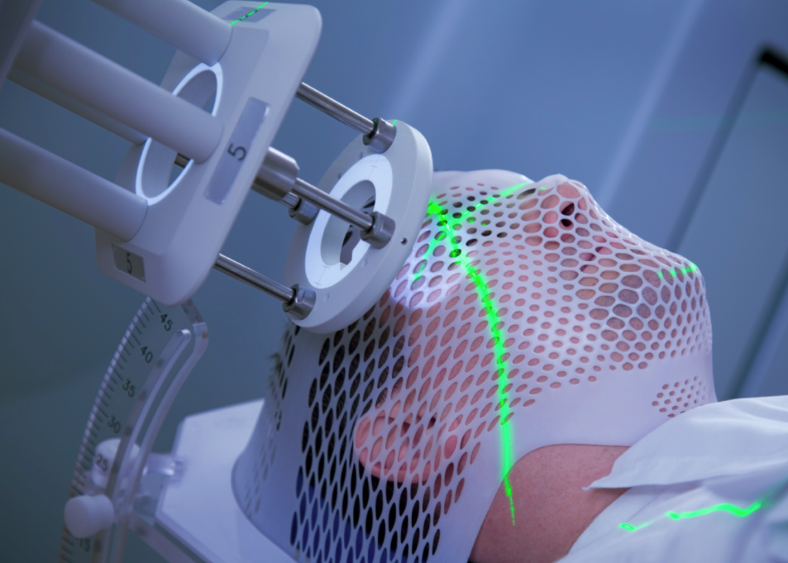
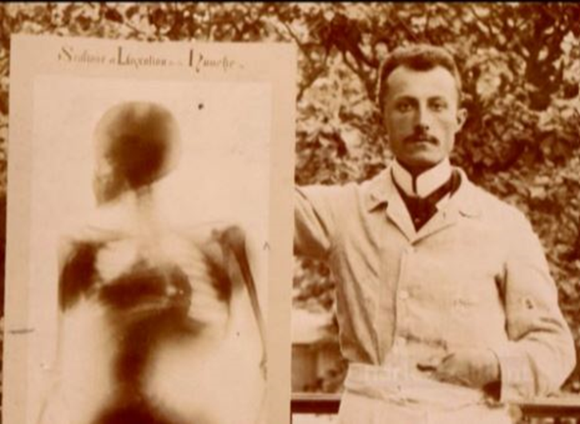

Important point: protection evolved
Managed harm: prevent deterministic effects
Manage probability of harm: reduce exposures ALARA
Genetic
Cancer
Notes:
ALARA – we’ve had some discussions where ALARA has sometimes morphed into an unhealthy competition…

Slide 14
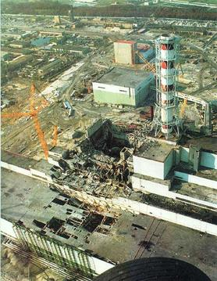
Then Chernobyl happened…
Notes:
The Chernobyl accident in 1986 was the result of a flawed reactor design that was operated with inadequately trained personnel.
The resulting steam explosion and fires released at least 5% of the radioactive reactor core into the atmosphere and downwind – some 5200 PBq (I-131 eq).
Two Chernobyl plant workers died on the night of the accident, and a further 28 people died within a few weeks as a result of acute radiation poisoning. fewer than 50 deaths had been directly attributed to radiation from the disaster, al
UNSCEAR says that apart from increased thyroid cancers, "there is no evidence of a major public health impact attributable to radiation exposure 20 years after the accident."
Resettlement of areas from which people were relocated is ongoing. In 2011 Chernobyl was officially declared a tourist attraction.

Slide 15
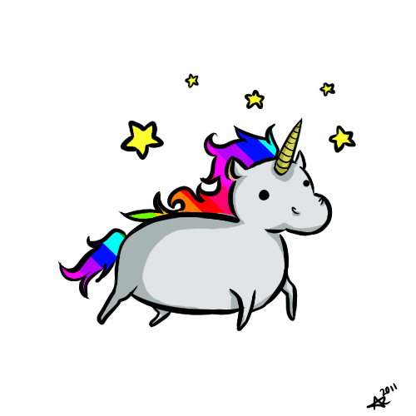
Notes:
Stop and take a breather…..this is our legacy, and it is important to not minimize the impact that these events have had on public perception and policy. But it is also critical to put it all of this into context

Slide 16
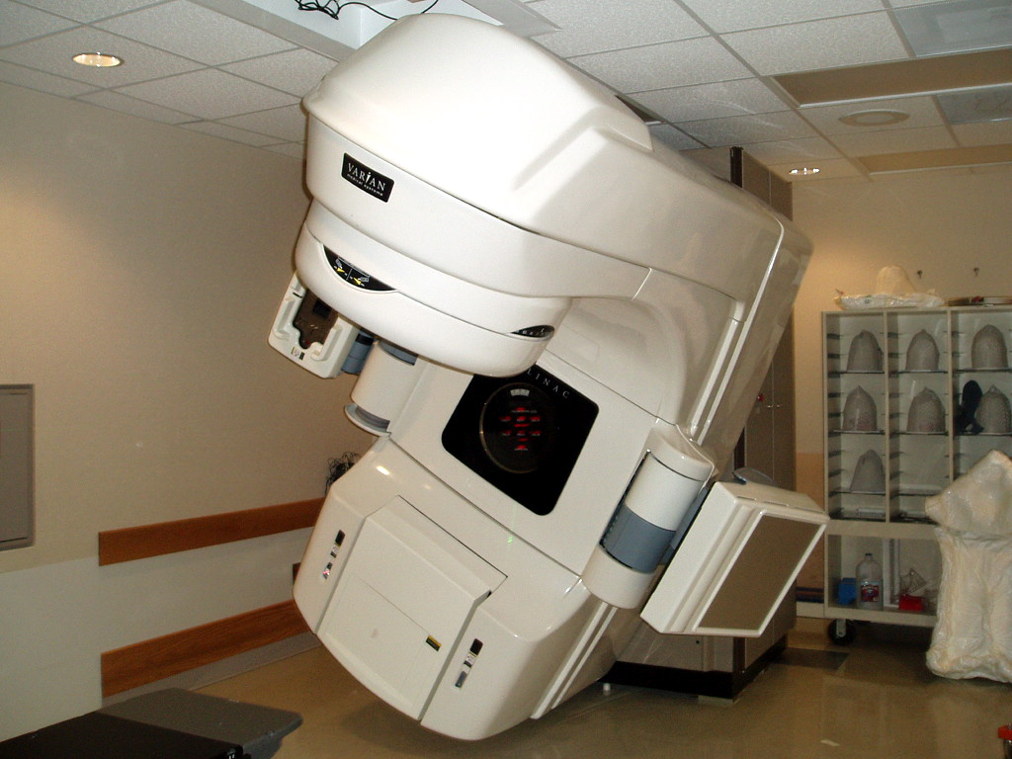
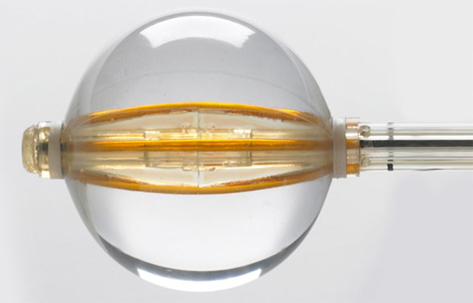
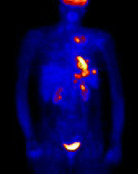
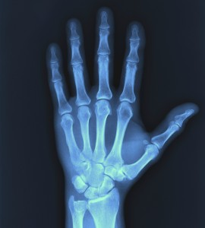
Benefits of radiation demonstrated
Notes:
Let us not forget the benefits of using radiation for diagnosis of injury or disease – radiation and radionuclides have been instrumental in health care applications
Or radiation therapy to treat inoperable cancers
Balloon brachytherapy device – these devices have led to eradication of cancer in patients

Slide 17
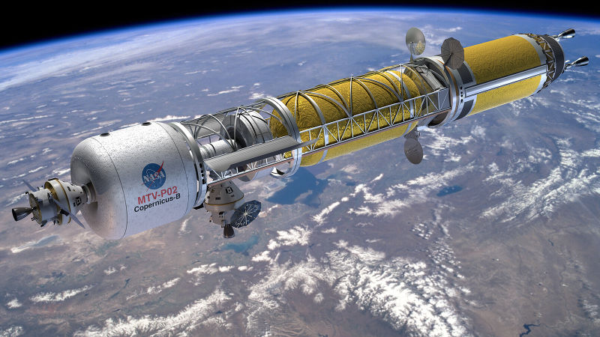
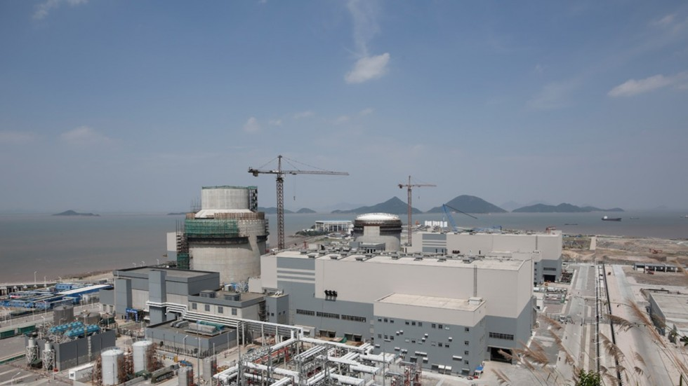
Unique capabilities of nuclear recognized
Notes:
The first people to step on to the surface of Mars won't arrive aboard the chemical-fueled rockets that delivered Apollo 11 to the Moon—they simply don't provide enough thrust to get to the Red Planet before exposing their crews to months of dangerous space radiation. Instead, NASA is turning to long-ignored nuclear-thermal rocket technology to deliver the first Martian explorers into history.
Nuclear technology is essential to deep space exploration
Nuclear power – low carbon high density energy source.
China has 20 nuclear power plants under construction, more than any other country on earth. With Sanmen, the industry is hoping to get the nod to build more reactors at home, and even export the AP1000 technology.
Address energy shortage, choking air pollution and more.
There have been three major reactor accidents in the history of civil nuclear power – Three Mile Island, Chernobyl and Fukushima. One was contained without harm to anyone, the next involved an intense fire without provision for containment, and the third severely tested the containment, allowing some release of radioactivity.
These are the only major accidents to have occurred in over 17,000 cumulative reactor-years of commercial nuclear power operation in 33 countries.

Slide 18
100000 -
10000 -
1000 -
100 -
10 -
1 -
0.1 -
0.01 -
Absorbed Dose, mGy
Dose Where Bad Things Happen
Dose Region Where Effects Are Observed
Significant Radiation or Nuclear Accidents
Radiation Therapy
Effective Dose, mSv
Natural Environment
Diagnostic Procedures
Dose Region Where Cancers Are Estimated Using Mathematical Models
Medical
Dose Where Nothing Really Happens
Accidental
│
│
│
│
│
│
│
Seconds Minutes Hours Days Weeks Months Years
Environmental
Duration of Exposure
Notes:
Why this is so challenging – accidents dominate the discussion – even though vast majority of our experience is at lower doses, the safety record of the us industry is excellent, and the radiation risk is small.
But it is our perception of risk that severely influences our decision making. And we can make some substantially bad decisions.
A couple of examples

Slide 19
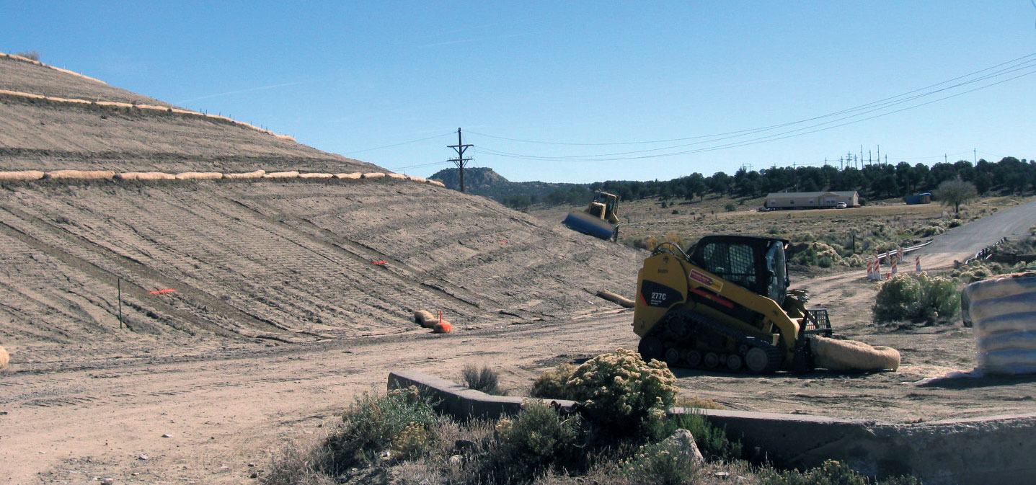
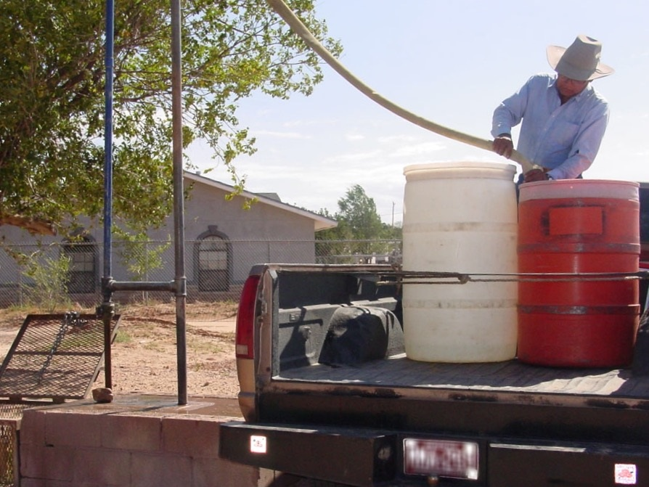
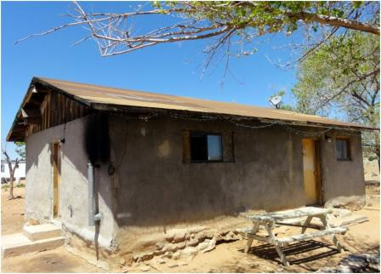
Navajo Nation
Notes:
From 1944 to 1986, nearly 30 million tons of uranium ore were extracted from Navajo lands under leases with the Navajo Nation. This website describes how five federal agencies are working together to reduce the highest risks to Navajo people from uranium contamination resulting from the abandoned mines.
https://www.epa.gov/navajo-nation-uranium-cleanup/eastern-abandoned-uranium-mine-region
NNEPA estimates that up to 30% of the population must haul water because they are not served by piped water systems.
IHS and HUD contributed $4.7M to construct the Monument Valley waterline extension to serve 128 homes without piped water.
The Navajo Nation estimates that up to 30% of the population (approximately 54,000 people) do not have piped water to their homes. These residents haul water either from safe watering points or from unregulated sources, such as livestock wells and springs. The number of unregulated water sources is estimated to be in the low thousands.
The use of unregulated water sources is the greatest public health risk associated with drinking water for the Navajo Nation.
https://www.epa.gov/sites/production/files/2016-06/water-hauling-station-in-ganado-lg.jpg

Slide 20
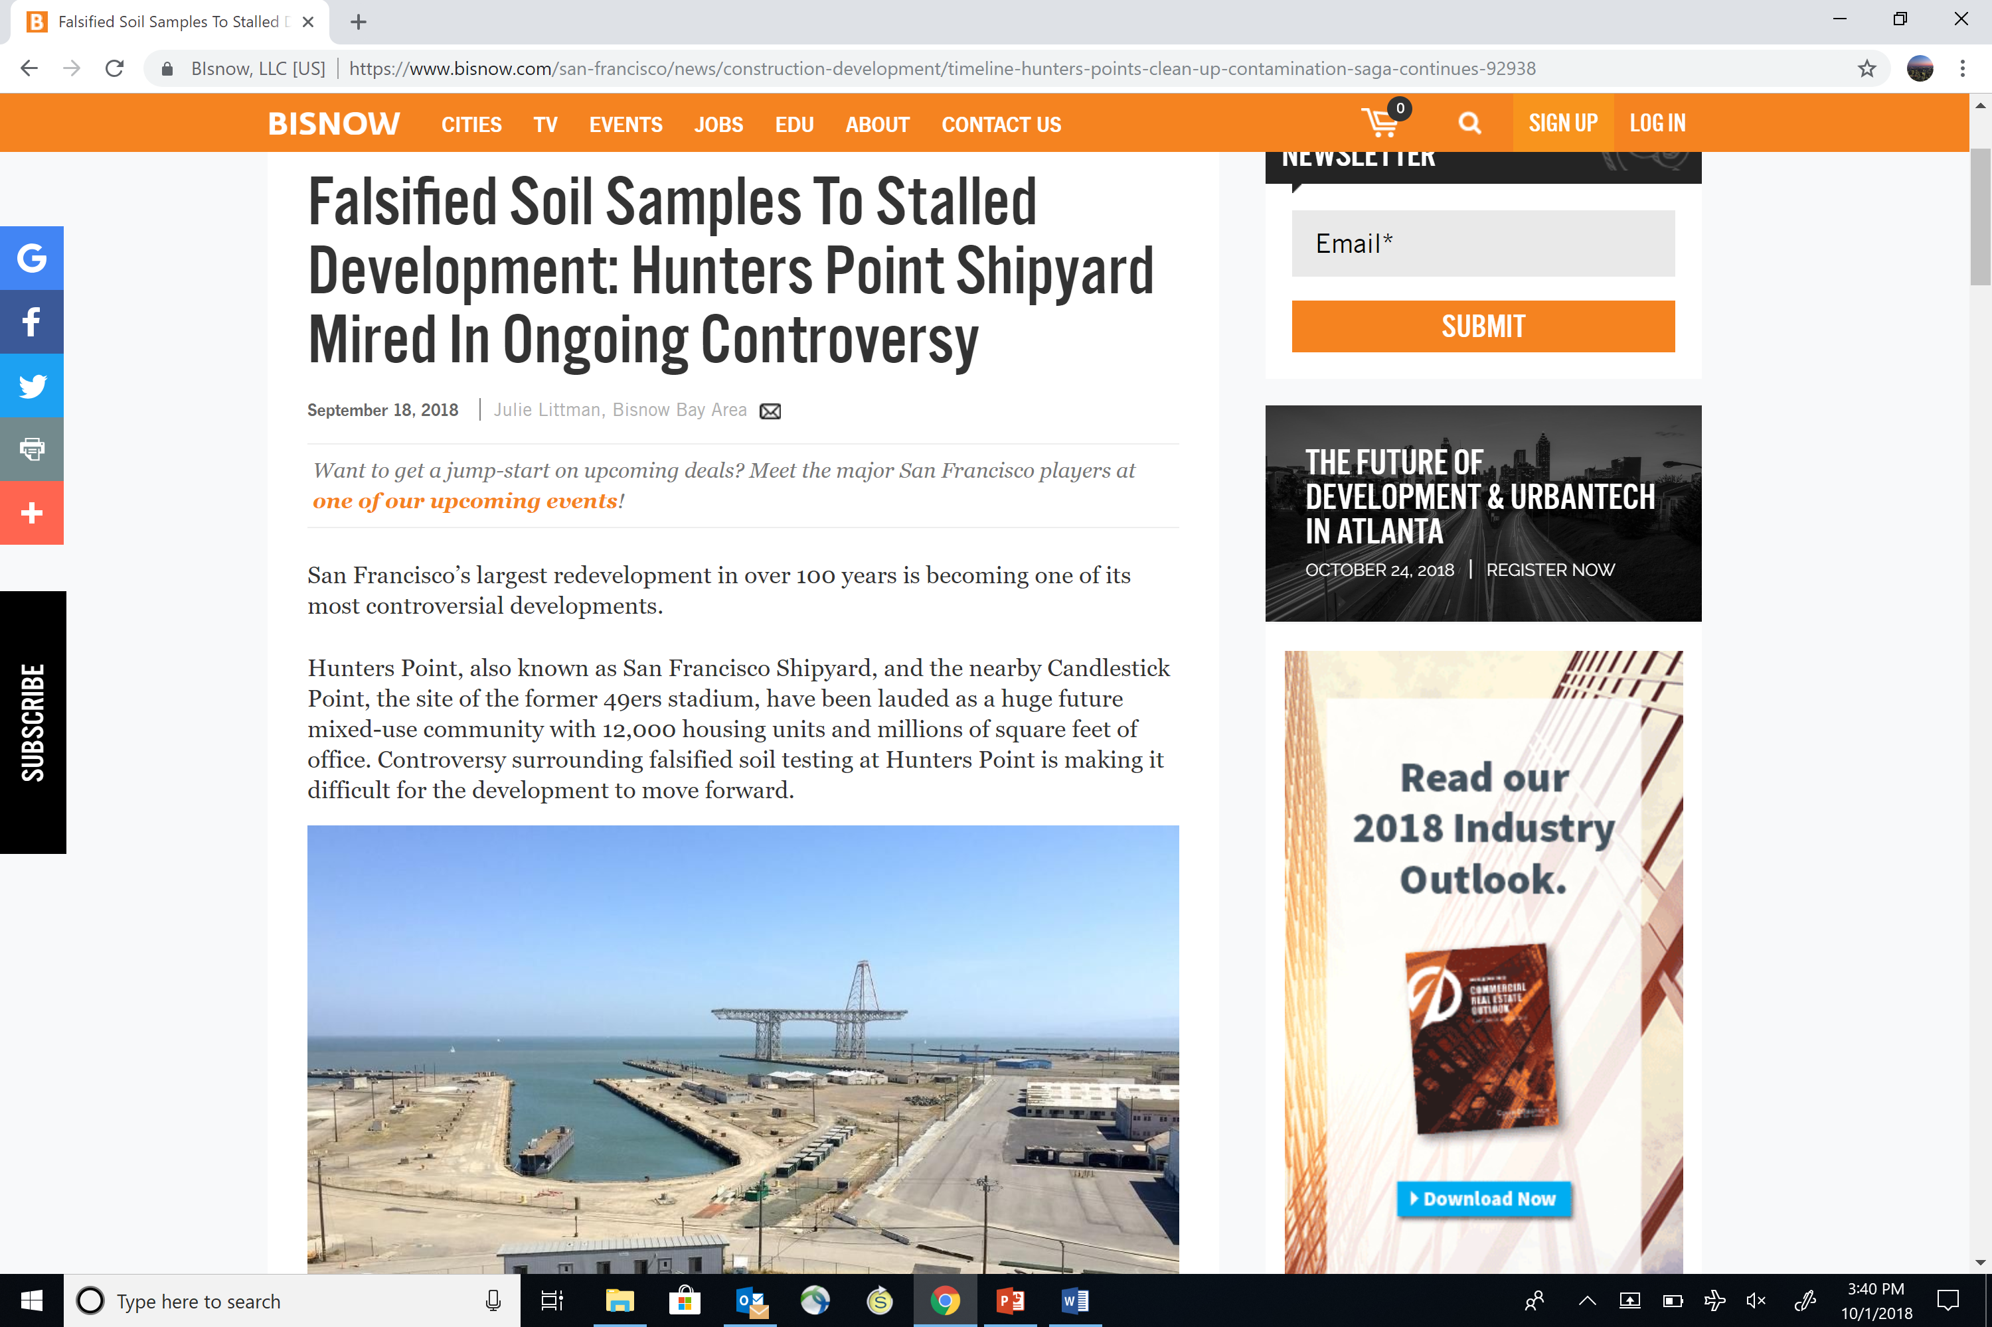
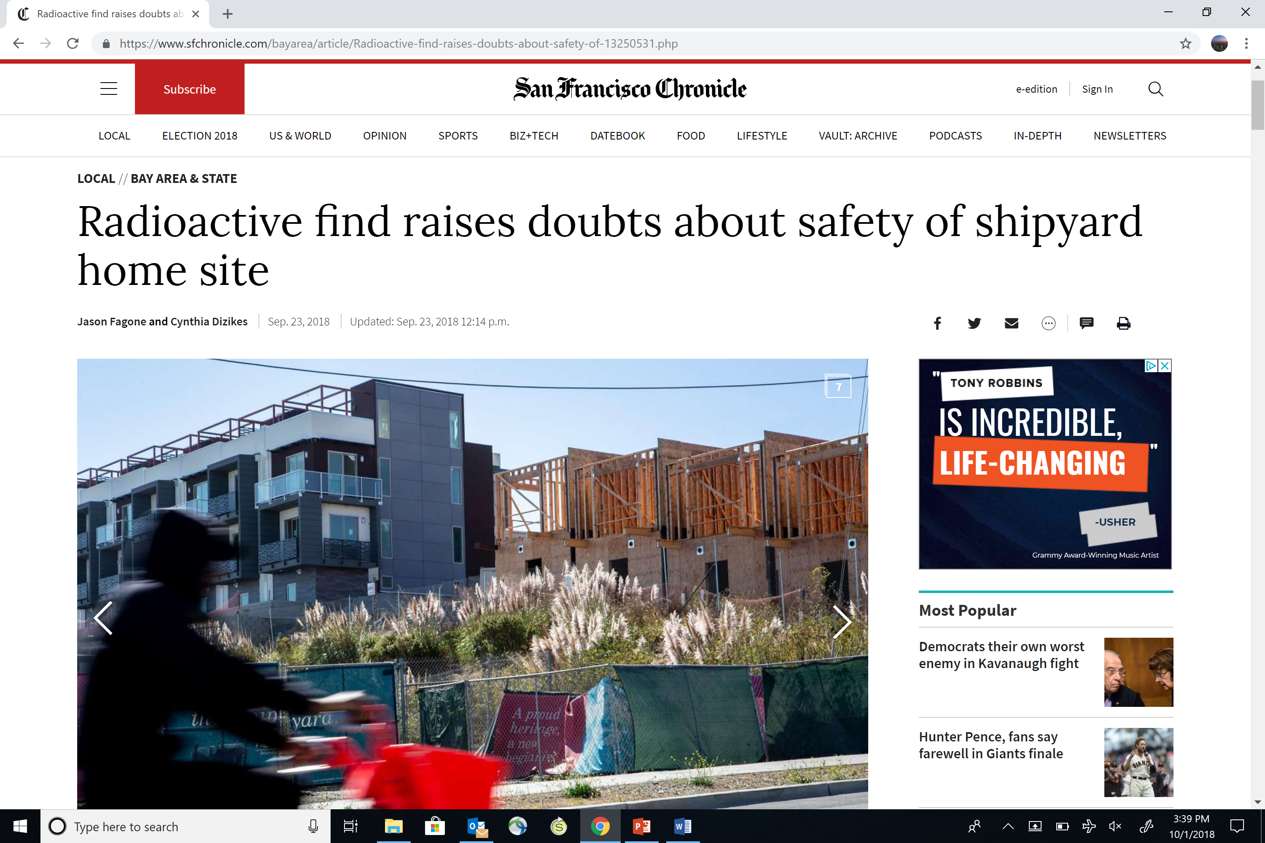
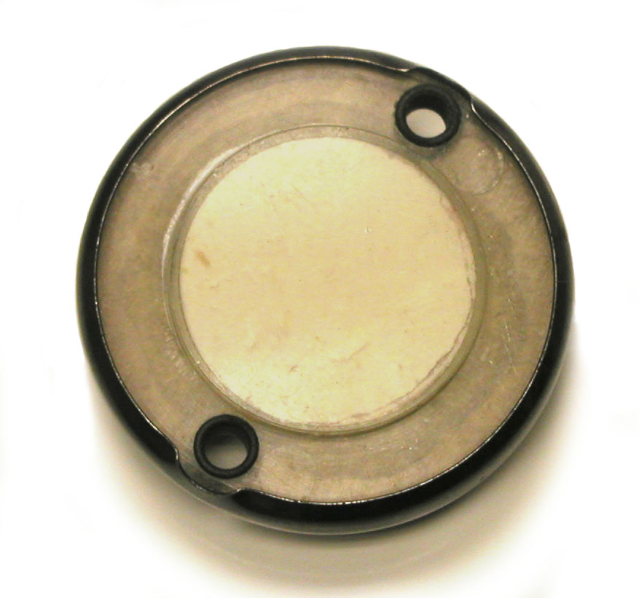
San Francisco Bay Area
Notes:
https://www.orau.org/ptp/collection/radioluminescent/deck.htm

Slide 21
So what do we do?

Slide 22
The Underpinnings of Protection
Science
Epidemiology
Radiobiology
Anatomy
Physiology
Metrology
Science
Values
Experience
Experience
Hiroshima/Nagasaki
Nuclear Installations
Industrial/Medical
Chernobyl
Fukushima
……
System
of Radiological Protection
Social and Ethical Principles/Values
Beneficence
Non-maleficence
Autonomy/Dignity
Justice
Prudence
It’s not just the numbers
Notes:
Since its beginnings, our radiation protection system has been characterized by its ability to adapt.
It first protected health practitioners and researchers.
Then, more broadly, it expanded to address other workers and the public in general.
now, it is being extended to the totality of the environment.
Over time, the guidance and recommendations have become more refined, diverse, and explicit.
Still, the underpinnings of the radiation protection system have been
1) our lived experience;
2) the evolving science; and
3) our shared social/ethical principles and values.
Within this structure, we continually take stock of what we have learned and what we value.
We should question if our current guidance remains fit for purpose.
That is exactly how the system was designed to function.
when we seek to change it, we must do so in a holistic and thoughtful manner.
understand and confront our biases,
acknowledge the very real gaps in our understanding of the science and the wider world, and
focus on what is important.
We have built a flexible, yet robust architecture
can respond and adapt as circumstances evolve.
We have worked within this framework for nearly one hundred years.
We need to trust that the process will continue to serve us well.

Slide 23

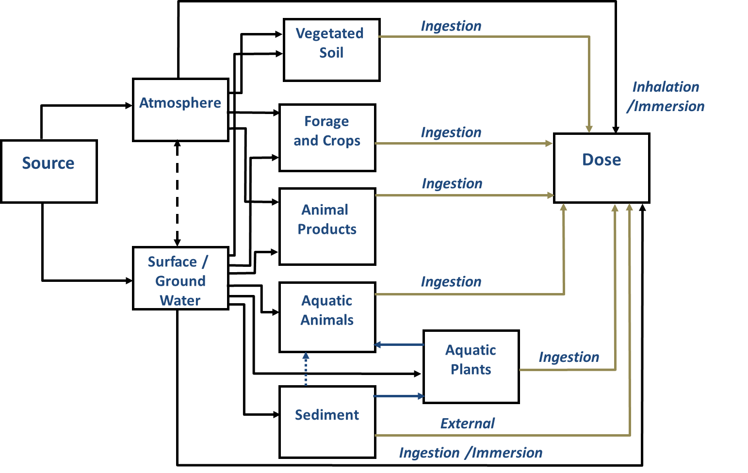
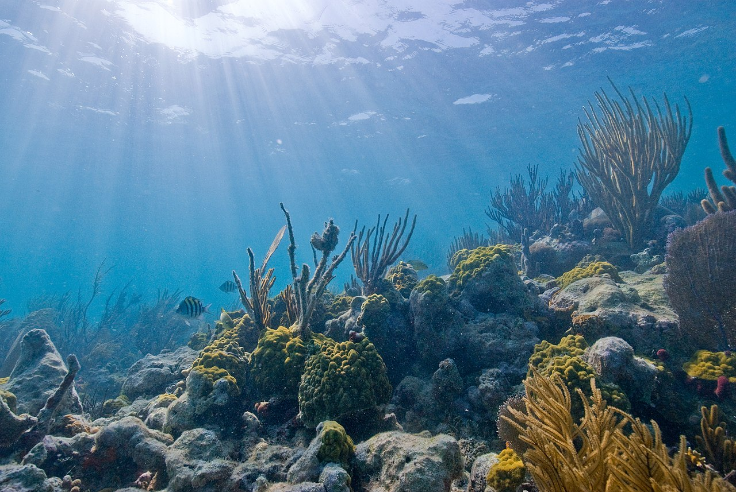

Some practical steps: realistic exposure scenarios
and include the environment
Notes:
When you are dealing with environmental exposures, you can’t measure dose. You model exposures and estimate dose and risk. One way to bring some common sense, is to utilize reasonable, and scientifically-based exposure scenarios to estimate risk. Unreasonable scenarios generate restrictive and untenable concentrations of radionuclides in the environment.
https://www.google.com/search?q=farmer+in+manhattan&source=lnms&tbm=isch&sa=X&ved=0ahUKEwjHkbvy6uXdAhVlHjQIHQVgAncQ_AUIDigB&biw=1500&bih=841#imgrc=Am_m2ezS-czwqM:
https://www.google.com/search?q=farmer+in+manhattan&source=lnms&tbm=isch&sa=X&ved=0ahUKEwjHkbvy6uXdAhVlHjQIHQVgAncQ_AUIDigB&biw=1500&bih=841#imgdii=DotM9rEtfSiPeM:&imgrc=Am_m2ezS-czwqM:
https://memphite.com/cm9vZiB2ZWdldGFibGUgZmFybWluZw/

Slide 24
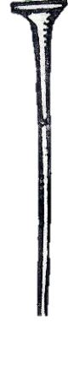
Keep things in perspective – are 100 mGy (10 rad) studies relevant to 0.04 mSv (4 mrem) standards?
Notes:
We’ve had a lot of conversation today about ‘low dose studies’ where the studies are in the Gy or centiGy range. These are not (from the perspective of an environmental HP, low doses). We need to find a way to figure out how to not get so enmeshed in the science that we are not able to see the forest (protection of the public) from the trees (the science of effects).

Slide 25
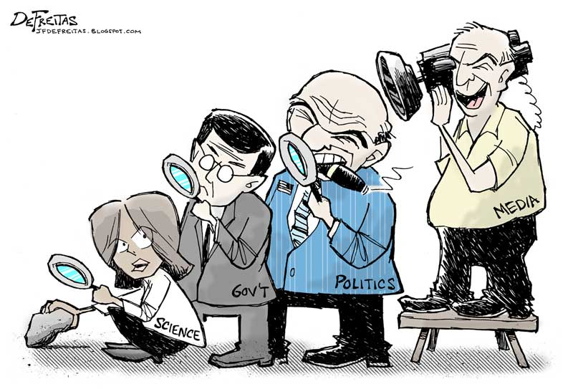
Notes:
How do we solve these complex problems? By recognizing that complicated questions require not just engineering, but social, political and values as part of the discussion. Then we can make a difference.
As an academic, I see solutions coming from our academic institutions. These are places to be proud of; not just for great science, amazing engineering, but also the more thorny discussion of values and inclusion and…. Science can help identify causes and point to solutions. Engineering can build the systems. But it is the well rounded understanding of the human condition that helps us create solutions that are equitable, just, and enduring.

Slide 26
Thank you. Questions?

